Slide 1
Circuits

Slide 2
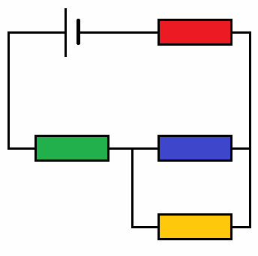
In this Smart Lesson you will review how to:
Distinguish between series and parallel circuits.
Explain Kirchhoff's current law.
Explain Kirchhoff's energy (voltage) law.

Slide 3
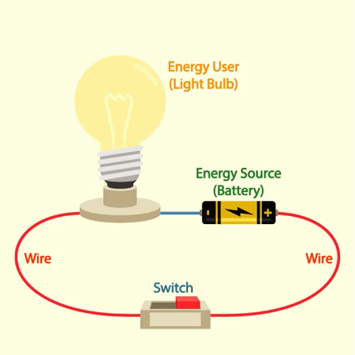
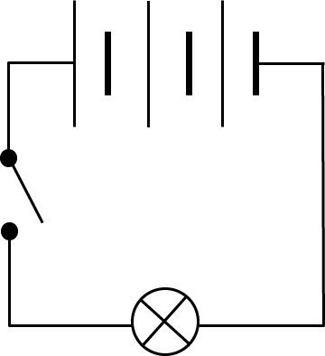
The two types of circuits are series circuits and parallel circuits.
A series circuit forms a single loop. All of the components are in a line.

Slide 4
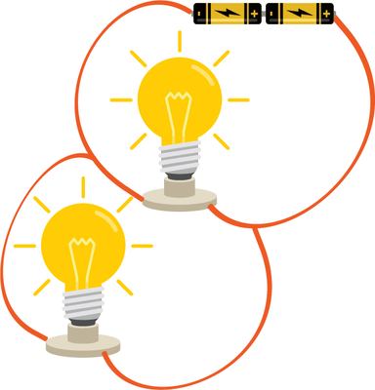
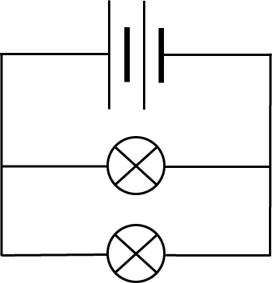
A parallel circuit has multiple branches.
Each branch has circuit components on it.

Slide 5
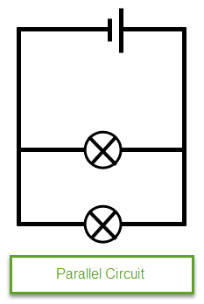
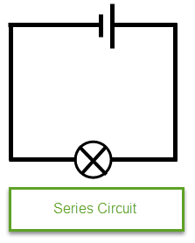
Series and parallel circuits.
In a series circuit, charged particles have only one pathway to travel through. Charges flow at the same speed across the circuit and do not leave as charge is conserved. Thus current is the same throughout the circuit.
Parallel circuits have multiple pathways for charged particles to travel through.
At a junction of three or more pathways the charges can travel in any direction, but the total number of charges arriving at a junction each second must be the same as the total number leaving the junction each second.

Slide 6
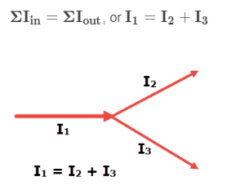
In circuits, charge is conserved as particles travel through the wires.
We know that the same number of charged particles leave a junction as do enter them.

Slide 7
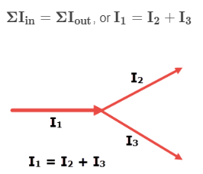
This rule is known as Kirchhoff's Current Law.
It states that the sum of all currents entering a junction is the same as the sum of all currents leaving that junction.

Slide 8
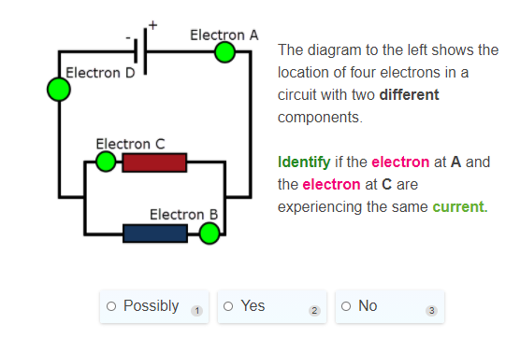

Slide 9
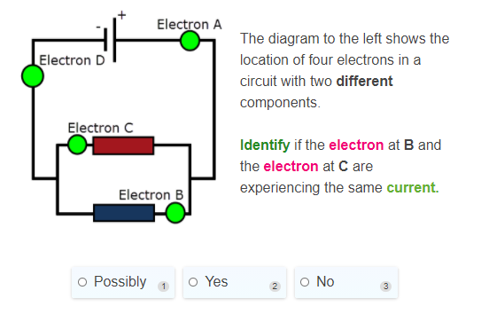

Slide 10
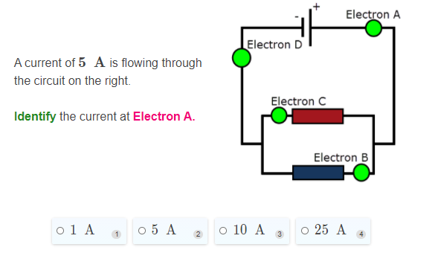

Slide 11
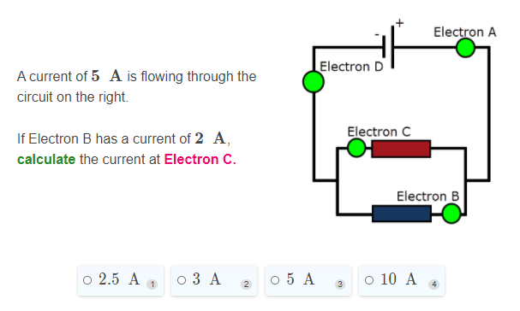

Slide 12
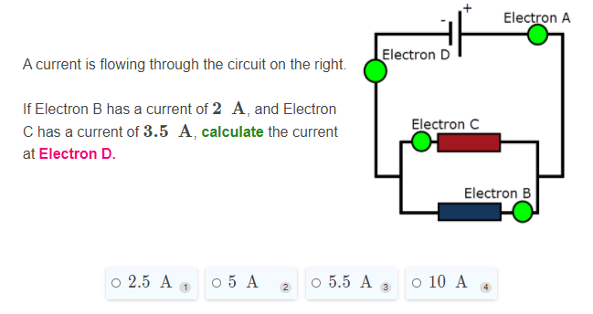

Slide 13
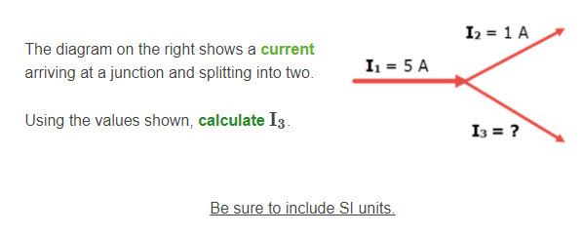

Slide 14
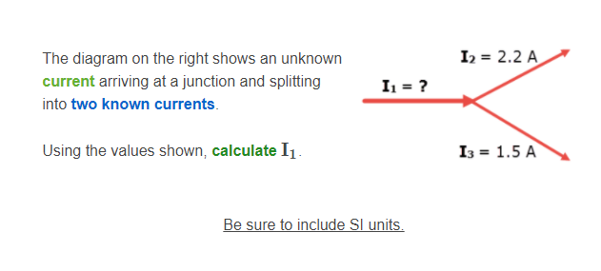

Slide 15
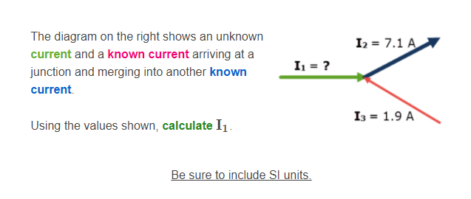

Slide 16
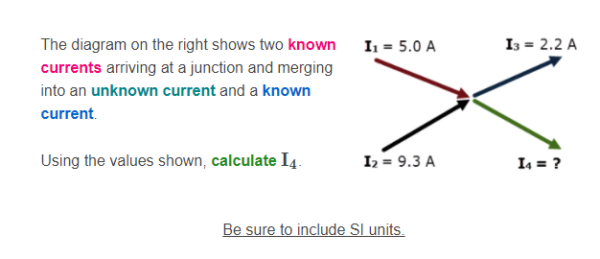

Slide 17
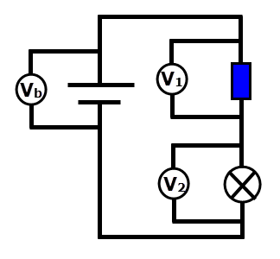
In any circuit, a source produces potential energy which is used by loads.
Below is a simple circuit with two loads, a resistor and a lamp. Voltmeters measure across each component.

Slide 18

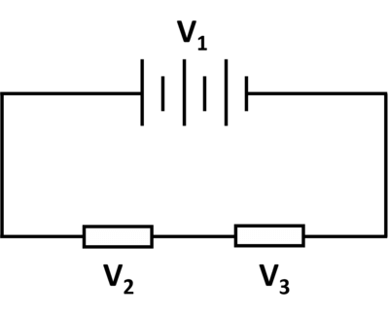
Kirchhoff's Energy (or Voltage) Law.
Kirchhoff's Energy (or Voltage) Law states that the total potential difference around a closed circuit is 0. Therefore the potential must be used by each load in the circuit.
where V₁​ is the voltage provided by the battery. The value of voltage across a load depends on the energy it uses, so different components often have different voltages.

Slide 19
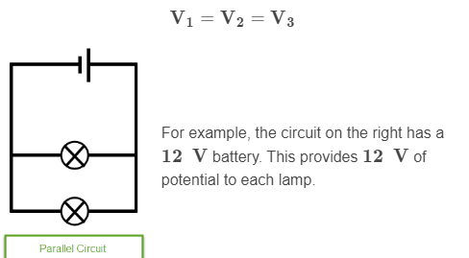
Kirchhoff's Energy (or Voltage) Law.
In parallel circuits, the same principle applies. A parallel section is treated as a single component and has one voltage across it which is equally applied to each branch.

Slide 20
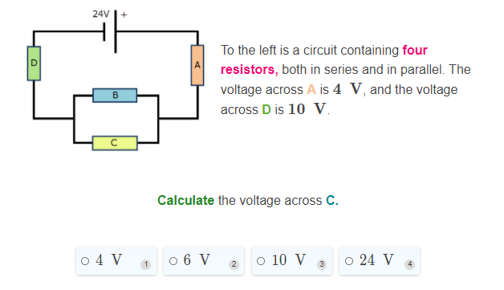

Slide 21
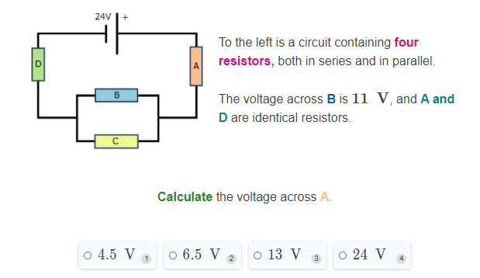

Slide 22
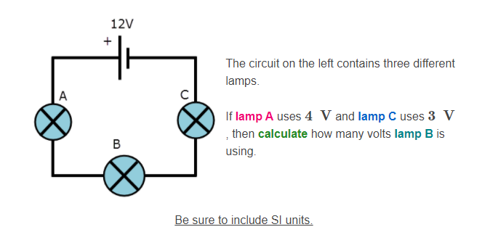

Slide 23
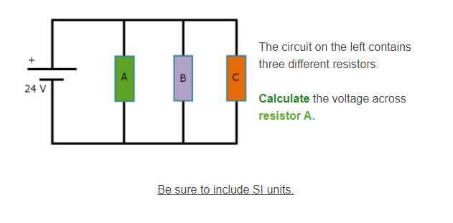

Slide 24
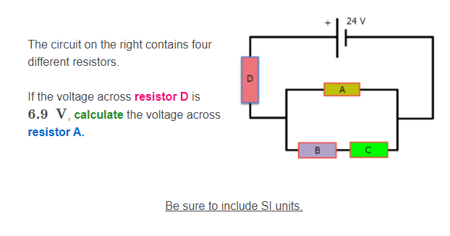

Slide 25
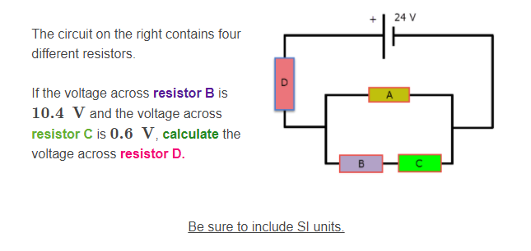

Slide 26
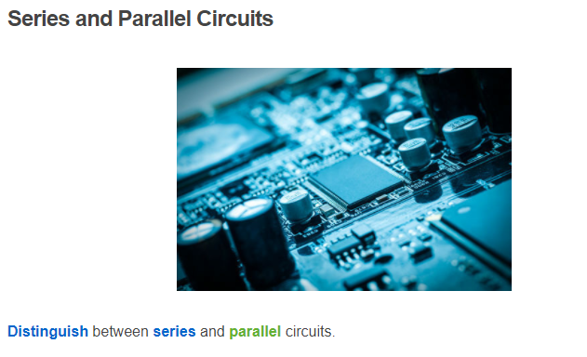

Slide 27
